Slide 1


Sprint delivery
Sprint 2
Wednesday 8 June, 2022

Slide 2
Content
Sprint 2
Sprint 3
Deliverables
What is next?

Slide 3
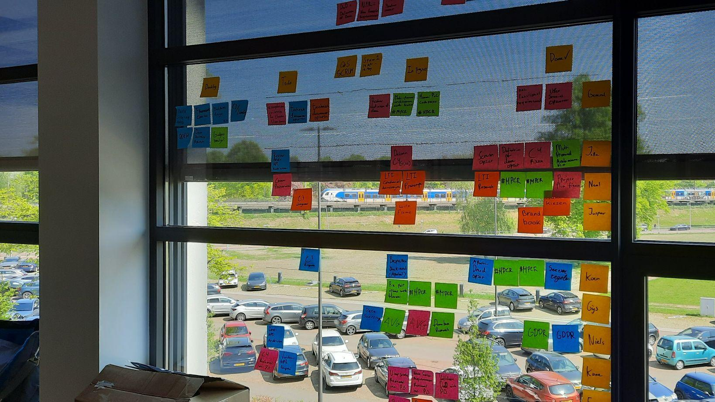
Sprint 2
“Prototyping Quantified student”
Notes:
The main mission for the first sprint

Slide 4
Deliverables - Context and container diagrams

Slide 5
Deliverables -

Slide 6
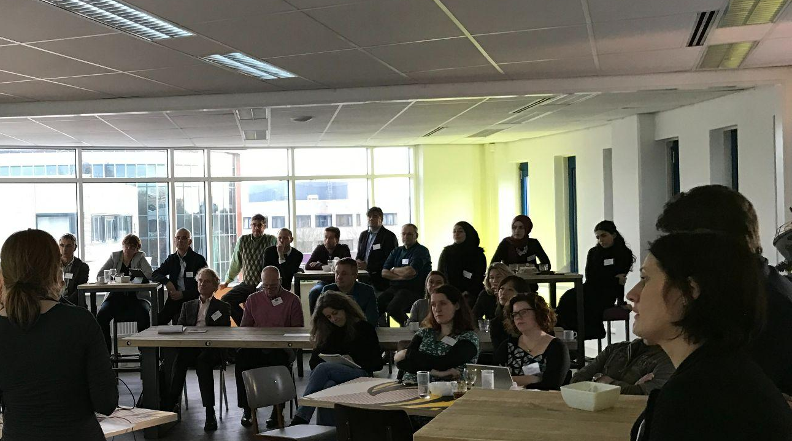
Next sprint.
Sprint 3

Slide 7
What is next?
What technologies are we going to use for the main API?
Other TO DO's
Are we using Apache Druid or a self made API or both?
Technical documents
LTI prototype
Setup API project
How will the data be displayed in the dashboard?
Creating a wireframe
Creating a prototype

Slide 8
End of sprint delivery
Any questions?
Wednesday 8 June, 2022

